Slide 1
TARGET2 & TARGET2 (im)balances
Part I Basics & Quiz
Nynke Doornbos
Macedonian Financial Sector Conference on Payments and Securities Settlement Systems (Ohrid 6)
Ohrid, 1 July 2013

Slide 2
Outline TARGET2 Basics
Role within the Payments Infrastructure
Concept Central Bank Money
Basic principles TARGET2:
Access criteria
Use of the system
Modules of TARGET2
TARGET2 business day
Pricing
Link to monetary policy, collateral, cash and clearing and settlement organisations.
2
2

Slide 3
Payments Cube
Flow per day EUR bn | Flow per day #
3,200 | 1
3,400 | 0.8
80 | 110
~4 | ~200
€
€
Amounts outstanding end 2011 EUR bn
42,700
1,500
4,400
858
Derivatives clearing
Oom Digoberts pakhuis
Paymentscube
Securities settlement
Large value Payments
Retailpayments
Cash
3
3

Slide 4
Large value payments layer
CLS
TARGET2
Correspondent
RTGS
Banking
Euro1
Banks
Participant
Large value payments
4
4

Slide 5
Concept of Central Bank Money
Major wholesale payments can be processed by public sector systems or by private sector systems
TARGET2 is a public sector system for wholesale payments
EURO1 is a private sector system for smaller wholesale and retail systems -> more efficient than public sector system
Public sector payment systems, like TARGET2, provide additional protection
When ancillary systems (securities settlement, OTC derivatives, CLS) settle in TARGET2 ->settlement in CEntral Bank Money (CeBM)
Settlement in private payment systems ->COmmercial Bank Money (CoBM)

Slide 6
TARGETGET2
Trans European
Automated
Real-Time
Gross Settlement
Express
Transfer system
http://www.ecb.int/paym/t2/html/index.en.html
6

Slide 7
TARGET2: What is it?
Real Time Gross Settlement (RTGS) system owned and operated by the euro system. Built by 3 NCBs (Bundesbank, Banque de France, Banca d’Italia)
Used for large value euro payments.
Technically centralised (1 system): uniform functionality, uniform pricing, high availability
Legally decentralised (maximally harmonised), business relation with ‘own’ Central Bank
7
7

Slide 8
TARGET2: Participating countries
The 18 euro area central banks (including the ECB)
Six central banks from non-euro area countries: Bulgaria, Denmark, Latvia, Lithuania, Poland and Romania.
countries connected to TARGET2
euro countries
other EU countries

Slide 9
TARGET2: access criteria 1/2
Credit institutions established in the EEA, including when they act through a branch established in the EEA.
Credit institutions established outside the EEA, provided that they act through a branch established in the EEA.
NCBs of EU Member States and the ECB.
9

Slide 10
TARGET2: access criteria 2/2
Treasury departments of central or regional governments of Member States active in the money markets:
e.g. treasury of Dutch Ministry of Finance and its agency
Organisations providing clearing or settlement services that are established in the EEA and are subject to oversight by a competent authority:
e.g. Equens and ESES
10
10
Notes:
02/06/11
10

Slide 11
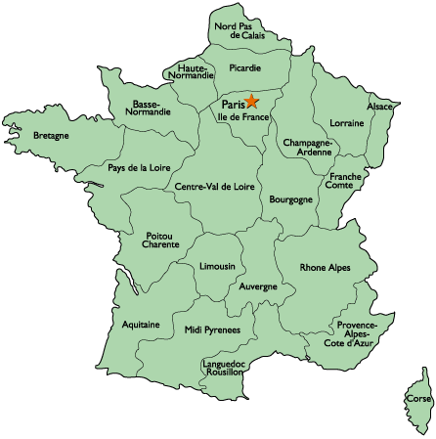
TARGET2: NO access
11
11
Notes:
02/06/11
11

Slide 12
TARGET2: participants (2012)
Direct participants : 1000
Banks: 900
Central banks: 25
Clearing and settlement organisations: 40
Other direct: 35
Indirect participants: 3386
Treasury and agency
Non-Euro Central Banks/Central Bank customers
12
12
Notes:
02/06/11
12

Slide 13
Central Bank Customers
Central banks outside the euro area holding an account at Central Banks like DNB.
Supra-national institutions (Development Funds)
Intergovernmental institutions
13
13
Notes:
02/06/11
13

Slide 14
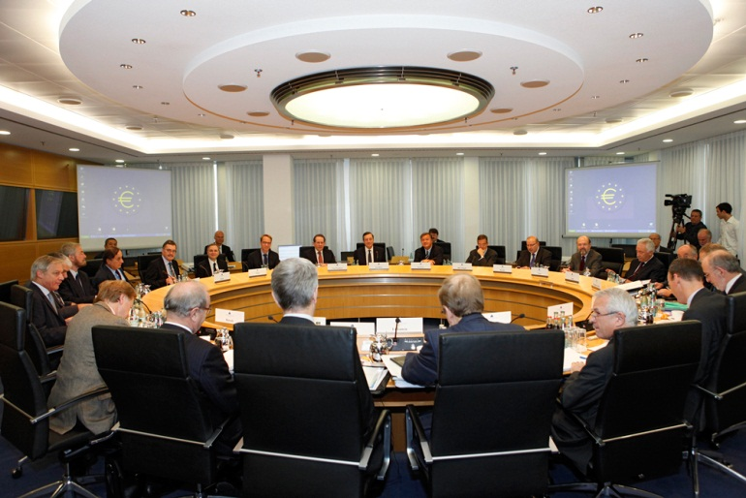
TARGET2: what is it used for?
Executing monetary policy:
lending to banks, secured by collateral (OMO)
Overnight deposit and marginal lending (standing facilities)
Reserve requirements
Settlement of other systems (e.g. CLS, EURO1, Equens (ACH))
(Large Value) Payments in euro (between banks)
Payments of banknotes
Payments from and to ESES
ECB Gov Council deciding on interest rate for lending
14

Slide 15
TARGET2: some numbers
TARGET2 Eurozone (2012):
354,185 payments (daily)
EUR 2,477 billion (daily)
average value: EUR 6.8 million
99.85% payments processed < 5 minutes
15
15
Notes:
02/06/11
15

Slide 16
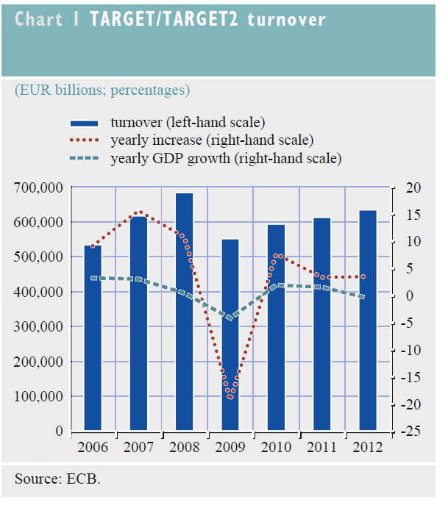
TARGET2 Turnover (2006-2012)

Slide 17
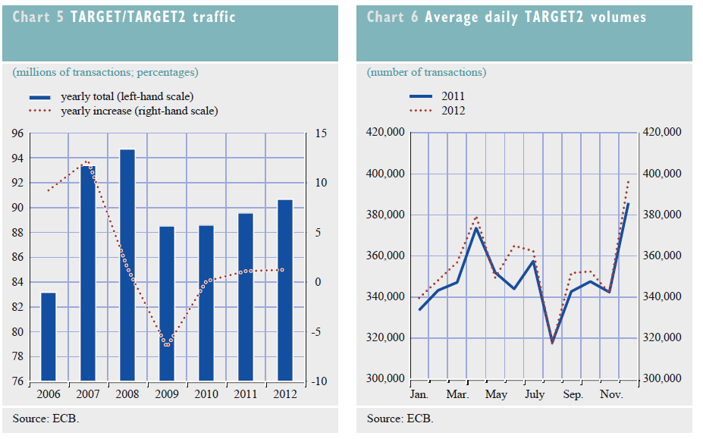
TARGET2 Traffic and daily averages (2006-2012)

Slide 18
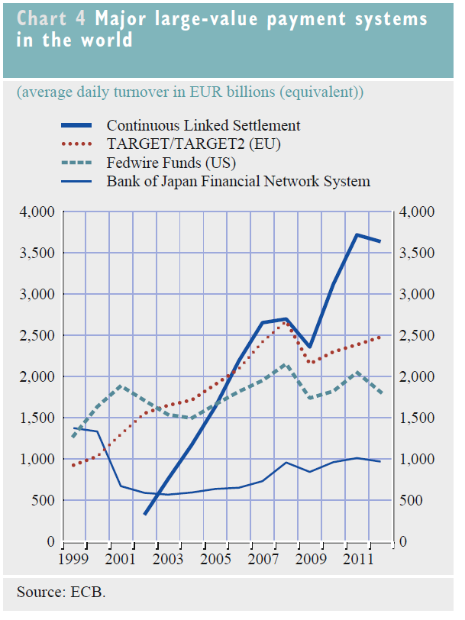
Major large value payment systems in the world

Slide 19
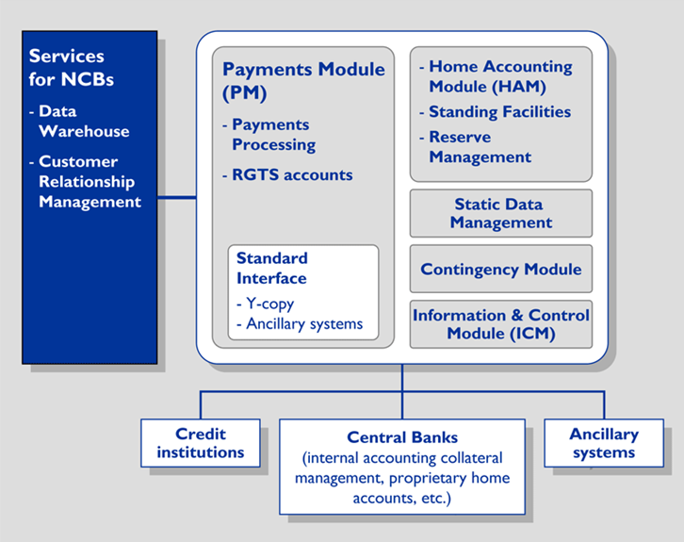
TARGET2 modules

Slide 20
TARGET2: modules
Payment Module (PM)
Core of platform: Processing of individual payments
Home Accounting Module (HAM)
Account module e.g. to hold reserves
NCB internal accounts
Standing Facilities Module (SF)
Overnight deposits and Marginal lending
Reserve Management Module (RM)
fulfillment of reserves requirements
CRSS: Data warehouse containing information on transactions
20
20
Notes:
02/06/11
20

Slide 21
Single Shared Platform
Centralized solution: single platform, no interlinking
central payments processing: DE, IT (workload distribution between regions)
central datawarehouse and customer services: FR
Region 1
Region 2
Region 3
SITE A
SITE C
SITE E
SITE B
SITE D
SITE F
payments and accounting services
customer related services

Slide 22
TARGET2: types of operations and businesses
All RTGS operations may be processed in TARGET2
wholesale payments are a main goal
individual operations settled in real-time and in central bank money
no exclusion according to amount or type of operations
All types of operations
credit transfers
mandated payments
direct debits (limited usage)
All types of business
payments between market participants
central bank operations
settlement operations of ancillary systems

Slide 23
Liquidity pooling - Virtual account
Credit institution e.g. Bank A1
Credit institution e.g. Bank A2
Credit institution Bank A3
Group account
Virtual balance: balance on (single) accounts + credit lines
Possibility to „use“ this position by each group account holder
Booking on the single accounts (not on the virtual account)
Only intra-day: „levelling“ off at the end of day mandatory
Notes:
Geheel nieuw is de mogelijkheid om rekeningen te groeperen in een zogenaamde pool. De total liquiditeit op alle rekeningen in de pool kan dan tbv van iedere rekening in de pool gebruikt worden. Deze functionaliteit is alleen beschikbaar intraday aan het eind van de dag dienen alle debet standen weggewerkt te zijn, dit gebeurt door middel van een specifiek proces dat aan het eind van de dag draait.
Deze faciliteit is toegevoegd naar aanleiding van de wensen van de grote banken, en biedt de mogelijkheid optimaal gebruik te maken van het feit dat er slechts 1 platform is.
Benadrukt moet worden dat het nog niet geheel zeker is of deze faciliteit ook daadwerkelijk geboden kann worden omdat nog neit alle juridische consequenties in kaart zijn gebracht.
Inmiddels is al wel duidelijk dat het niet mogelijk zal zijn om een rekening die bij een out-NCB (UK,DK,SE) wordt aangehouden op te nemen in een rekening pool.

Slide 24
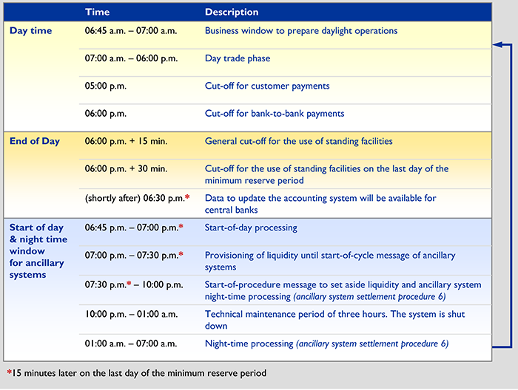
TARGET2 business day
24

Slide 25
TARGET2 pricing
Banks can choose between:
EUR 100, -/month and EUR 0.80/ transaction
EUR 1250,-/month and per transaction…
Band | Volume from | Volume to | price
1 | 1 | 10,000 | EUR 0.60
2 | 10,001 | 25,000 | EUR 0.50
3 | 25,001 | 50,000 | EUR 0.40
4 | 50,001 | 100,000 | EUR 0.20
5 | Above 100,000 | - | EUR 0.125
25
25
Notes:
02/06/11
25

Slide 26
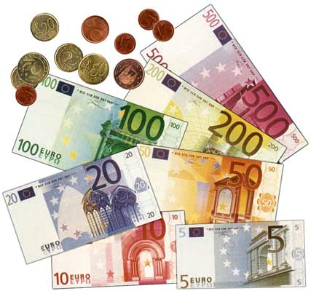
TARGET2: Benefits
Payments settled:
Quickly
with finality
1 technical system within the ESCB with the same functionality.
Only minor legal deviations.
1 pricing scheme.
No competition between central banks.
26
26
Notes:
02/06/11
26

Slide 27
Summary
Commercial banks directly benefit of a technically centralized platform (legally it is a decentralized system)
One pool of liquidity, one window for info on all TARGET payments

Slide 28
TARGET2: Quiz (1/5)
TRUE or FALSE:
TARGET2 is the largest Real-Time Net Settlement system of the euro area for euro payments.
Technically there are minor differences between TARGET2 components, but legally there are no differences.
TARGET2 settles all values from EUR 0.01 to EUR 1,000,000 billion.
28
28
Notes:
02/06/11
28

Slide 29
TARGET2: Quiz (2/5)
TRUE or FALSE:
All payments finally settle in the books of the European Central Bank
The main reason to operate TARGET2 is to facilitate x-border payments
It is not possible to settle securities transactions in T2

Slide 30
TARGET2: Quiz 3/5
TRUE or FALSE:
TARGET2 is always operational on 2 sites
TARGET2 is operational 24/5
Each and every NCB in the EEA is obliged to use TARGET2 for making Euro payments

Slide 31
TARGET2: Quiz 4/5
TRUE or FALSE:
All NCBs have access to the details of payments of each and every individual payment-order
Liquidity pooling is a must for banks who operate in more than one Euro-country

Slide 32
TARGET2: Quiz 5/5
Can you name 4 different institutions who are allowed to operate an account in T2?
Can you name 4 institutions who are not allowed to operate an account in T2?
Who is the owner of T2?
Who operates T2?
32
32
Notes:
02/06/11
32

Slide 33
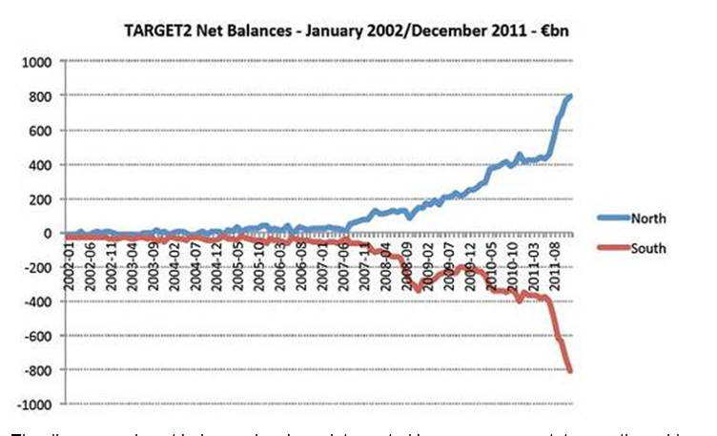
TARGET2 Part II TARGET balances
Nynke Doornbos
Macedonian Financial Sector Conference on Payments and Securities Settlement Systems (Ohrid 6),
Ohrid, 1 July 2013

Slide 34
Target balances
Indicator of stress in the eurozone

Slide 35
Target balances - topic
The intra Eurosystem claims are not easy to grasp
Great interest in academic and political circles
What are they and how do they emerge?
Example with three NCB’s and the ECB
Development of claims Bundesbank and DNB

Slide 36
Target balances - basis
Decentralization in monetary union has consequences for the balance sheets of the central banks
See example DNB payment before and after EMU to other NCB e.g. Deutsche Bundesbank:

Slide 37
Cross border payment before EMU
Clean opening
DNB
Bundesbank
Assets 1000
Total 1000
Bank notes 500
Cur.acc. 200
Buba 0
Other 300
Total 1000
Assets 2000
DNB 0
Total 2000
Bank notes 1000
Cur.acc. 400
Other 600
Total 2000
Result
Bank notes 500
Cur.acc. 100
Buba 100
Other 300
Total 1000
Assets 2000
DNB 100
Total 2100
Bank notes 1000
Cur.acc. 500
Other 600
Total 2100
Assets 1000
Total 1000

Slide 38
Target balances of national central banks
In Monetary union no bilateral account relationship between NCB’s
Everything vis-à-vis ECB (a ‘central counterparty’)
ECB
DNB 100
Buba 100

Slide 39
Cross border payment in EMU
Clean opening
DNB
Bundesbank
Assets 1000
Total 1000
Bank notes 500
Cur.acc 200
ECB 0
Other 300
Total 1000
Assets 2000
ECB 0
Total 2000
Bank notes 1000
Cur.acc. 400
Other 600
Total 2000
Result
Bank notes 500
Cur.acc. 100
ECB 100
Other 300
Total 1000
Assets 2000
ECB 100
Total 2100
Bank notes 1000
Cur.acc. 500
Other 600
Total 2100
Assets 1000
Total 1000

Slide 40
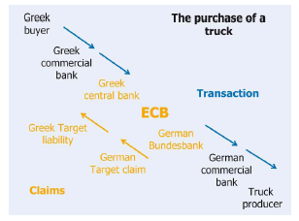
Greek buyer buys German truck – impact on TARGET2 balance

Slide 41
Target balances
Simple balance sheet exercise with
Three NCB’s
De Nederlandsche Bank
Bundesbank
Banca d’Italia
and
ECB

Slide 42
Target balances – exercise 1/5 clean opening
DNB
Banca d’Italia
Assets 2000
Total 2000
Banks 1000
Other 1000
Total 2000
Assets 2000
Total 2000
Banks 1000
Other 1000
Total 2000
ECB
Bundesbank
Assets 1000
Total 1000
Liabilities 1000
Total 1000
Assets 5000
Total 5000
Banks 2000
Other 3000
Total 5000

Slide 43
Target balances exercise 2/5
Example 1: Italian bank pays on behalf of a client EUR 500 to a Dutch bank
DNB
Banca d’Italia
Assets 2000
T-claims 500
Total 2500
Banks 1500
Other 1000
Total 2500
Assets 2000
Total 2000
Banks 500
T-liabi. 500
Other 1000
Total 2000
ECB
Bundesbank
Assets 1000
Target IT 500
Total 1500
Liabilities 1000
Target NL 500
Total 1500
Assets 5000
Total 5000
Banks 2000
Other 3000
Total 5000

Slide 44
Target balances exercise 3/5
Example 2: Dutch bank lends in interbank transaction 300 to a German bank
DNB
Banca d’Italia
Assets 2000
Total 2000
Banks 500
T-liabi. 500
Other 1000
Total 2000
Assets 2000
T-claims 200
Total 2200
Banks 1200
Other 1000
Total 2200
ECB
Bundesbank
Assets 1000
Target IT 500
Total 1500
Liabilities 1000
Target NL 200
Target DE 300
Total 1500
Assets 5000
T-claim 300
Total 5300
Banks 2300
Other 3000
Total 5300

Slide 45
Target balances exercise 4/5
Example 3: Italian bank receives 1000 in 3-year LTRO
DNB
Banca d’Italia
Assets 2000
T-claims 200
Total 2200
Banks 1200
Other 1000
Total 2200
Assets 2000
LTRO 1000
Total 3000
Banks 1500
T-liabi. 500
Other 1000
Total 3000
ECB
Bundesbank
Assets 1000
Target IT 500
Total 1500
Liabilities 1000
Target NL 200
Target DE 300
Total 1500
Assets 5000
T-claim 300
Total 5300
Banks 2300
Other 3000
Total 5300

Slide 46
Target balances exercise 5/5
Example 4: Italian bank repays money market loans: EUR 200 to a Dutch and EUR 300 to a German bank
DNB
Banca d’Italia
Assets 2000
T-claims 400
Total 2400
Banks 1400
Other 1000
Total 2400
Assets 2000
LTRO 1000
Total 3000
Banks 1000
T-liabi. 1000
Other 1000
Total 3000
ECB
Bundesbank
Assets 1000
Target IT 1000
Total 2000
Liabilities 1000
Target NL 400
Target DE 600
Total 2000
Assets 5000
T-claim 600
Total 5600
Banks 2600
Other 3000
Total 5600

Slide 47
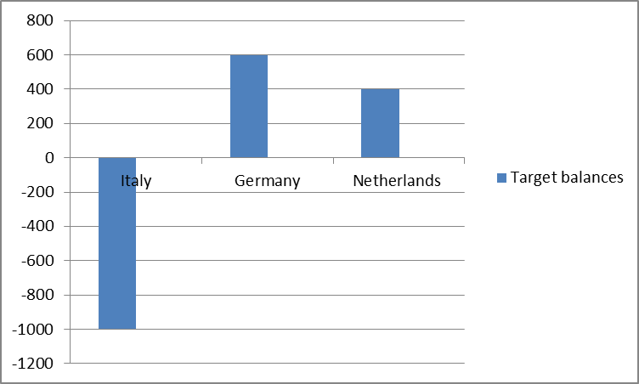
Target balances

Slide 48
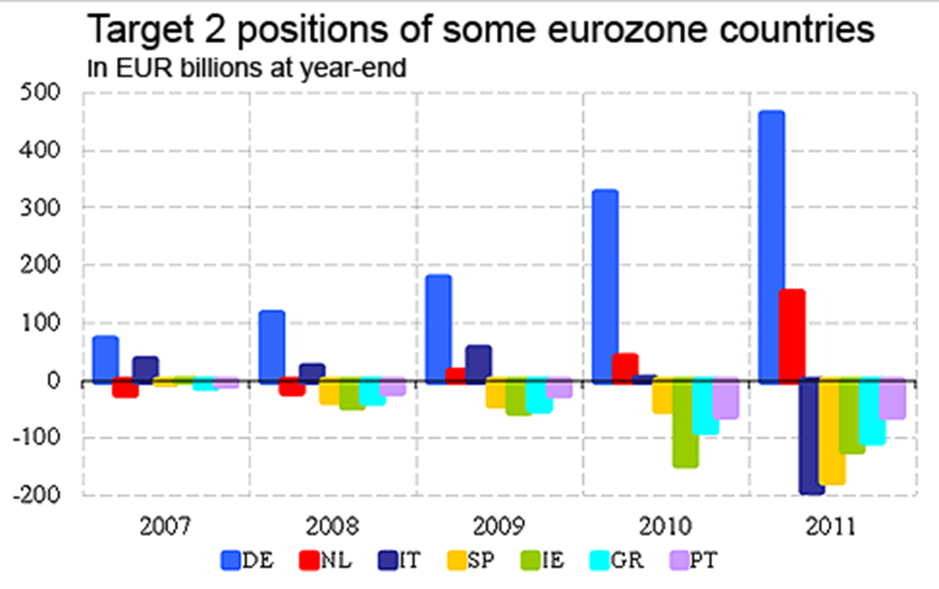
Target balances of euro area NCBs (year end)

Slide 49
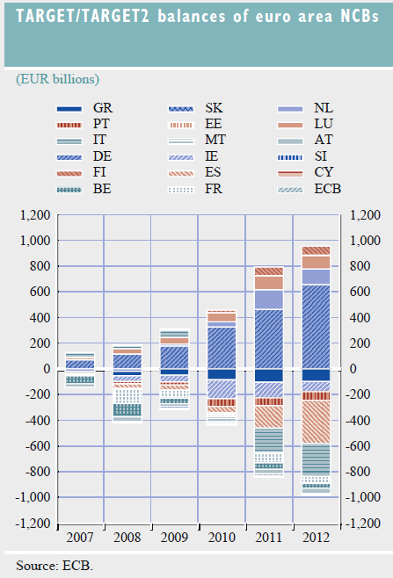
TARGET 2 balances of euro are NCBs have become more unbalanced

Slide 50
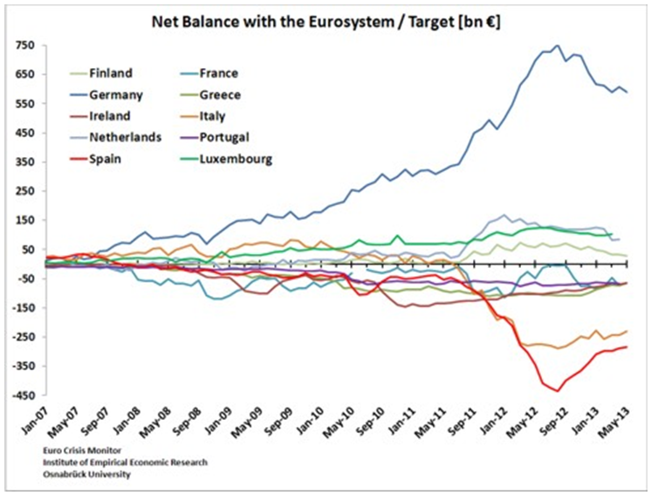
Actual (Im)balances TARGET2

Slide 51
Target imbalances – root cause
Explanation
Technical: settlement cross border payments, flows not balanced
Root cause: sovereign and banking crisis
net outflow of private capital, replaced
by central bank funding
Monetary union with decentralized operations
Notes:
THE TARGET2 BALANCES OF NATIONAL CENTRAL BANKS (NCBS)
TARGET2 allows commercial banks in Europe to settle their payments transactions on a shared platform and in central bank money, as well as allowing the settlement of Eurosystem central bank operations. When a bank makes a payment to a bank in another country in TARGET2, this changes the banks’ current accounts at the respective central banks. The settlement of these cross-border payments in TARGET2 results in intra-Eurosystem balances which are automatically aggregated and netted out at the end of each day. This leaves each central bank with a single net bilateral position (i.e. claim or liability) vis-à-vis the ECB.

Slide 52
Target balances of NCB’s
NCB net payment outflow will lead to TARGET2 liability
NCB net receipt of cross border payments will result in TARGET2 claim

Slide 53
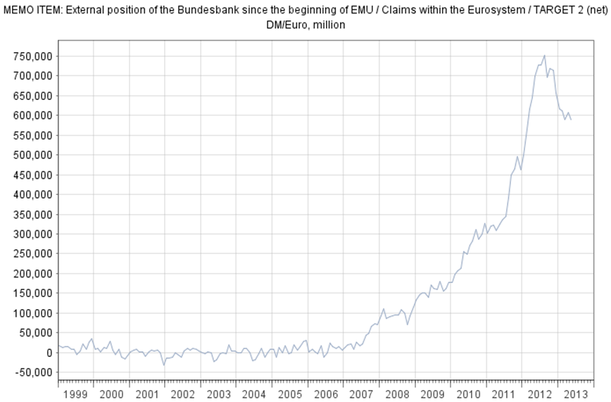
Balance end of September Eur 695 bn.
Start crisis in August 2007
Source: Website Bundesbank, http://www.bundesbank.de/Navigation/EN/Statistics/Time_series_databases/Macro_economic_time_series/its_details_charts_node.html?tsId=BBK01.EU8148B

Slide 54
Target balances - developments
Before the crisis: stable because cross-border payments broadly balanced
Since crisis unbalanced, interbank transactions ceased
Impairment of market funding led to more central bank funding (e.g. LTRO’s)
TARGET2 imbalances will decrease once vulnerable countries and their banks regain market access
Notes:
Before the crisis, TARGET2 balances were relatively stable because cross-border payment flows tended to be broadly balanced across the euro area.
Since the start of the crisis, TARGET2 liabilities have increased considerably for some NCBs.
This increase in TARGET2 negative balances is due to the fact that in the countries in question payment outflows in euro have not been matched by payment inflows in euro.
At the same time, access to funding by private markets in those banking systems has become dramatically impaired.
The net outflows in cumulative terms in those banking systems have required more central bank liquidity than usual.
The Eurosystem provided these funds via its non-standard monetary policy measures. In doing so it ensured that solvent banks were not liquidity-constrained in their funding (notably by virtue of the fixed rate full allotment procedure).
This resulted in an uneven distribution in the provision of central bank liquidity in the Eurosystem, as reflected in the TARGET2 balances. Those NCBs that provided more liquidity than usual to their banking system in net terms are the ones that have a negative TARGET2 balance vis-à-vis the ECB, while the NCBs that provided less liquidity in net terms are the ones that have a claim vis-à-vis the ECB.
As the latter banking systems have net payment inflows from other euro area countries, they have ample liquidity available and they have less need than usual for recourse to monetary policy operations in order to continue lending to households and firms in their economies.
In the context of the monetary union, a TARGET2 claim is not necessarily a measure of the financial risk exposure of the NCB in question. The risk associated with the provision of central bank liquidity to banks as part of monetary policy implementation is mitigated by a risk management framework, which includes the requirement of adequate collateral valued at market prices and subject to haircuts. Besides the pledge of collateral the banks remain fully responsible for their borrowings obtained from the Eurosystem. The residual risk that may emerge despite risk management features is, as a rule, shared among the euro area NCBs according to their share in the ECB’s capital. The claims or liabilities that relate to TARGET2 are regularly published by all Eurosystem central banks as part of their balance sheets. As far as the publication of the consolidated balance sheet of the Eurosystem is concerned, intra-Eurosystem balances (such as those related to TARGET2) are not reflected since their sum total is zero.

Slide 55
Target balances
QUESTIONS?

